Slide 1
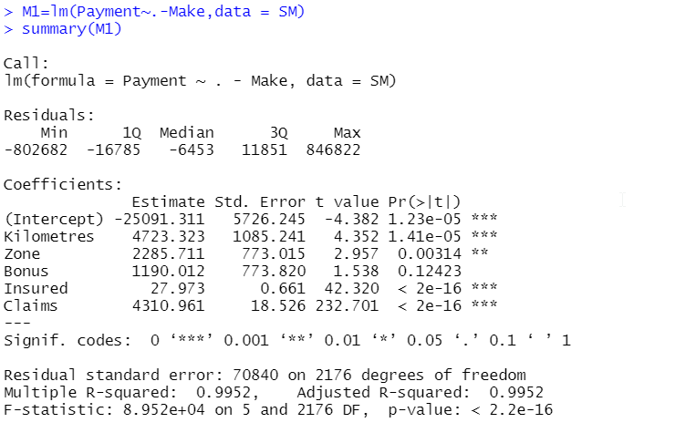
Problem statement can be addressed using
- Linear Regression
-Regression Trees
We will use LR first
P values for all varables except Bonus are below 0.05
Hence removing Bonus variable as it is insignificant while we understand impact on payment
P values for all varables except Bonus are below 0.05
Hence removing Bonus variable as it is insignificant while we understand impact on payment

